Slide 1
Smart agriculture system 2.0

Slide 2
index
Abstract
Components
Working
Functions and working summary
Diagram
Conclusion

Slide 3
Abstract
The Smart Agriculture Monitoring System is an automated solution designed to enhance crop management and irrigation efficiency using IoT technology. This system integrates a variety of sensors, actuators, and a stepper motor mechanism to monitor and manage plant health in a linear agricultural setup.
The project features an ESP32 microcontroller as the core controller, interfacing with moisture sensors, a temperature sensor, an ultrasonic sensor, and a motion sensor. Moisture sensors are deployed for three plants arranged in a linear partition, each triggering a response when soil moisture levels drop below a predefined threshold. A stepper motor with x axis direction , driven by an A4988 driver, moves along a 400mm ballscrew to locate the target plant. A mini water pump is activated to spray water at the correct location, ensuring precision irrigation.
The ultrasonic sensor monitors the water level in the tank, and a buzzer alarm alerts users if the level becomes critically low. Additionally, the temperature sensor records environmental conditions near the plants, while a motion sensor enhances security by triggering a loud alarm upon detecting unauthorized movement. The system integrates Wi-Fi connectivity, allowing real-time sensor data storage to a cloud platform and enabling remote control via a mobile application.
To ensure usability in offline scenarios, the system provides local notifications through LED indicators, a buzzer alarm, and an LCD I2C display that showcases real-time data, including soil moisture levels, water tank levels, temperature, and motor positioning status.
This project aims to optimize water usage, reduce manual intervention, and improve agricultural productivity through real-time monitoring and automation, offering an innovative solution for smart farming practices.

Slide 4
Components required
Stepper motor
Lead screw thread with lead nut (400mm)
Esp32/esp8266
Motor driver A4988N
Led for indications
Moisture sensor
Ultrasonic sensors
Pcb board
Display i2c
Resister
App for controlling
Water pumps
Temperature sensor
Motion sensor

Slide 5
Working
The system utilizes an ESP32 microcontroller to automate irrigation and monitor critical environmental parameters for three plants arranged in a linear configuration. Each plant is equipped with a moisture sensor placed at designated positions along the motorized axis, controlled by a NEMA17 stepper motor and an A4988 driver. The ESP32 calculates the position of the motor's lead nut based on rotational steps and determines the target plant's location when any moisture sensor detects low soil moisture. Once identified, the motor moves to the corresponding plant, and a mini water pump activates to spray water efficiently. Additionally, an ultrasonic sensor monitors the water level in the tank and sends the data to a connected mobile app using a Wi-Fi network, enabling remote access and real-time updates. All sensor values, including moisture levels, temperature readings from a temperature sensor, and water tank levels, are stored in the cloud for future analysis, while the motor can also be remotely controlled via the app. To ensure functionality during offline operation, the system triggers an audible alarm and displays notifications locally through an LCD screen. A motion sensor adds an extra layer of security, which can be toggled on or off via the app; upon detecting movement, it activates a loud sound alert. The display provides real-time status updates, including sensor data, motor operations, and security alerts, making the system a robust and efficient smart agriculture solution.

Slide 6
Workflow summary
Workflow Summary
Moisture Monitoring: Sensors check soil moisture. If low, the motor moves to the corresponding plant, and the pump sprays water.
Water Tank Monitoring: Ultrasonic sensor measures water level. Low water triggers alerts (buzzer, app notification).
Temperature Monitoring: Temperature data is displayed and sent to the cloud.
Motion Detection: If enabled, motion triggers an alarm.
Display: Real-time updates of all data on the LCD screen.
Cloud and Offline Mode: Sensor values are sent to the cloud when online. In offline mode, alerts use alarms and LEDs.
Water content spary based on plant

Slide 7
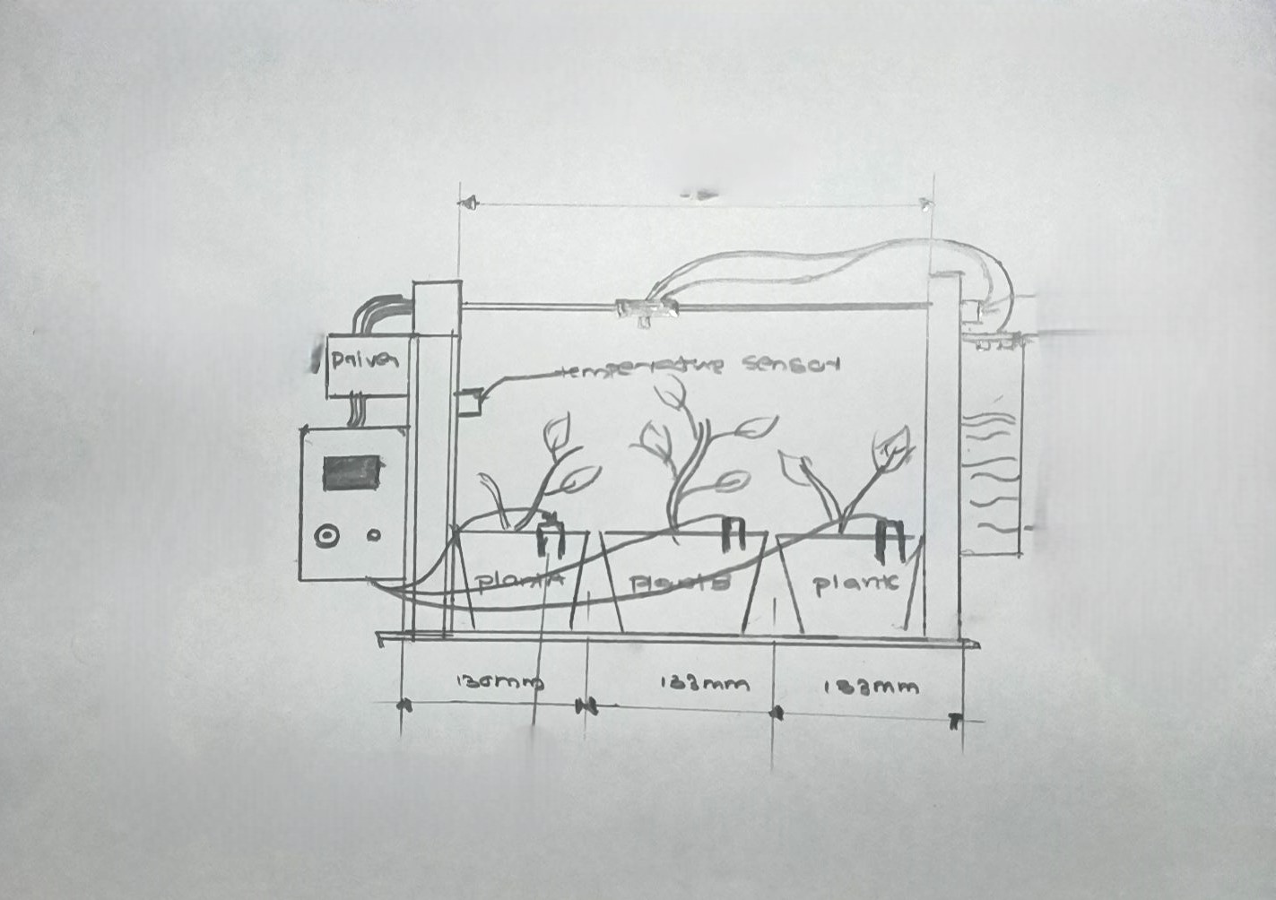
Diagram

Slide 8
Conclusion
The Smart Agriculture Monitoring System effectively integrates IoT technology and automation to optimize irrigation and environmental monitoring in a linear plant arrangement. By combining sensors, a stepper motor system, and cloud connectivity, the system ensures precise water delivery based on real-time soil moisture data while monitoring critical parameters such as water tank levels and ambient temperature. The inclusion of an ultrasonic sensor for water level detection, motion sensing for security, and an LCD display for real-time updates enhances the system's reliability and usability.The system's ability to operate both online and offline, providing notifications via alarms and cloud-based platforms, ensures consistent functionality regardless of connectivity. This project reduces manual intervention, improves water management, and provides remote monitoring capabilities through Wi-Fi and cloud storage. Ultimately, the Smart Agriculture Monitoring System represents an innovative solution for modern farming, promoting resource efficiency, automation, and improved crop health.

